Slide 1
Using an IDE
Chris Baldassano
PSYC GR6130, Fall 2019

Slide 2

Problems with notebooks
https://news.ycombinator.com/item?id=17856700

Slide 3
Problems with notebooks
Notebooks start to break down once a project gets complicated:
Hard to break analyses into modular files
Limited help (autocompletion and static code checking)
Can’t (easily) perform step-by-step debugging
Can’t interface with testing frameworks
Limited git integration (and figures break git diff)

Slide 4
Features of IDEs
IDE = Integrated Development Environment

Slide 5
Features of IDEs
Typically organized around projects, which track multiple files and the dependencies between them
Provide a unified graphical interface to many development tools (code “linting”, debugging, git, …)
Substantially more complex than using just a basic text editor or jupyter notebook – makes the most sense for analyses that are complex (>100 lines of code) or intended to be publicly distributed as a library/toolbox

Slide 6
R and Python IDES
RStudio (R)
PyCharm (Python)
Spyder (Python)
Atom (Python and R)
Sort-of IDEs:
Sublime Text (Python and R)
Emacs/Vim (Python and R)

Slide 7
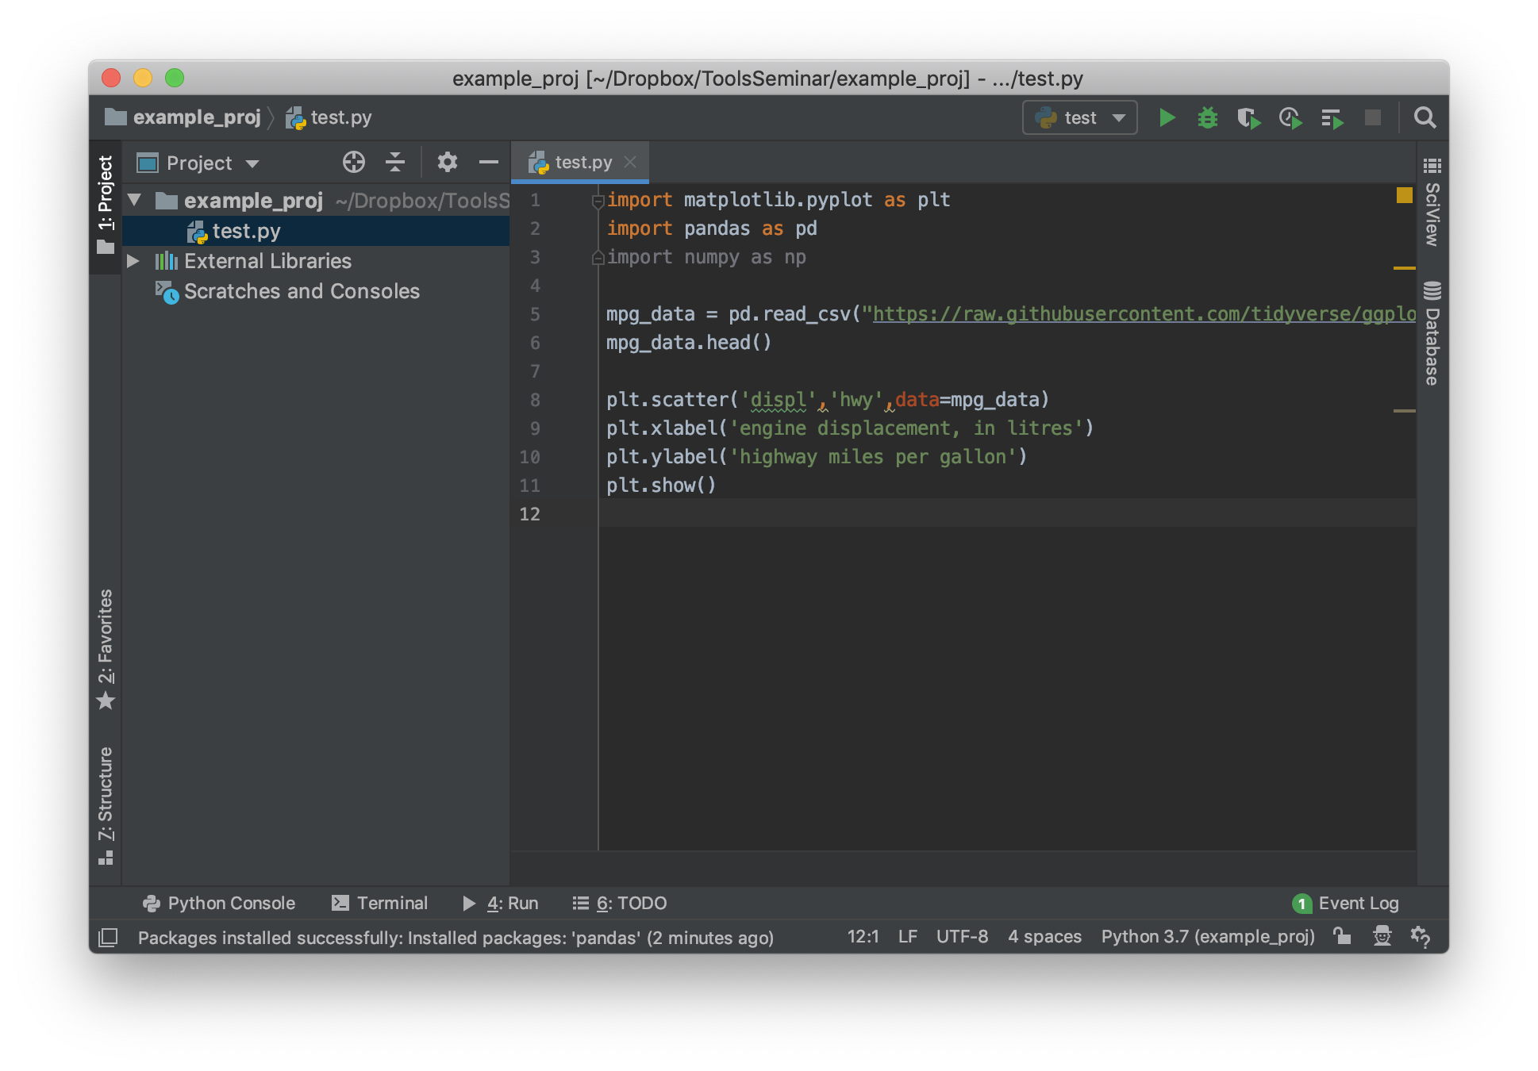
Pycharm

Slide 8
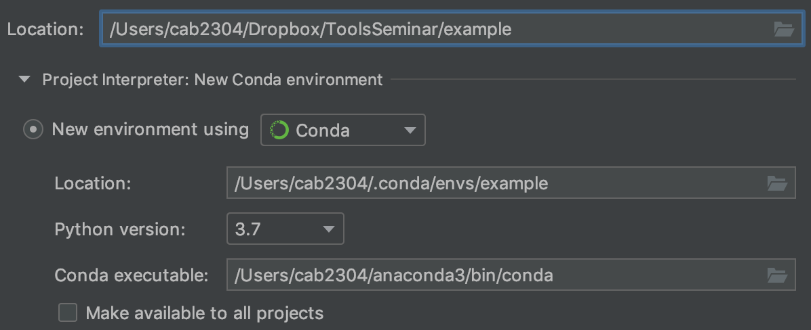
Conda Environments
Anaconda environments – create a sandbox for a particular project, install libraries only in this one environment
Prevents “dependency hell” of dealing with incompatible library requirements

Slide 9
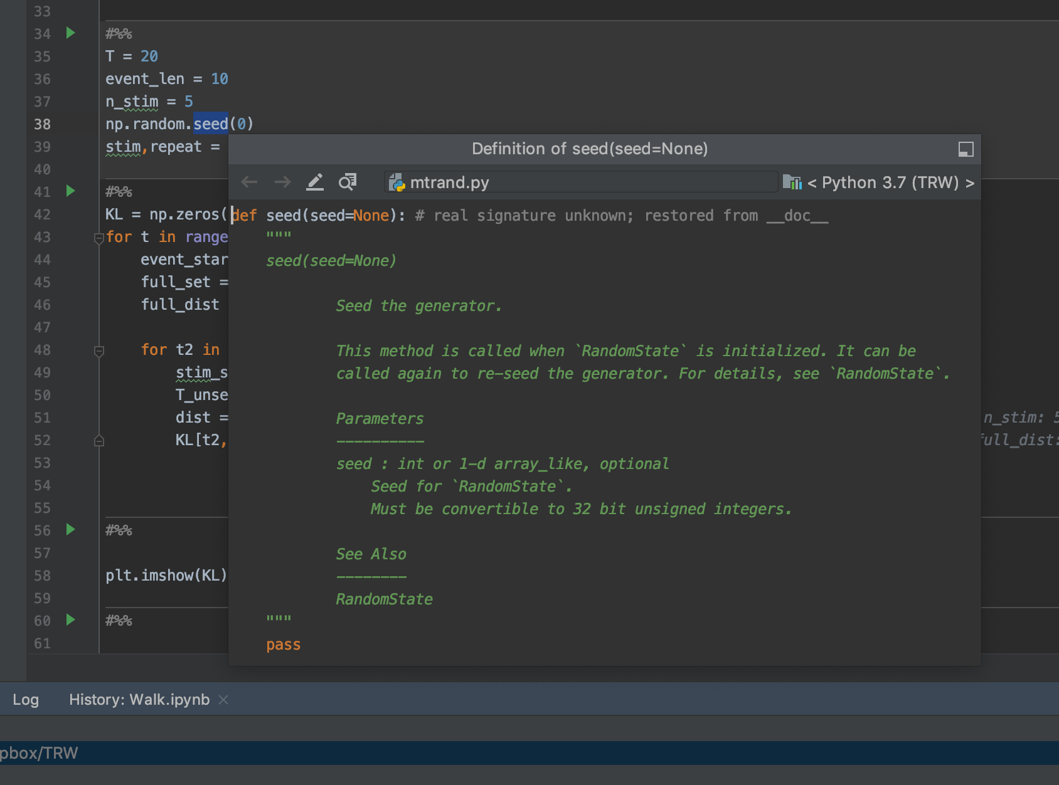
Looking up Documentation
View-> Quick Definition

Slide 10
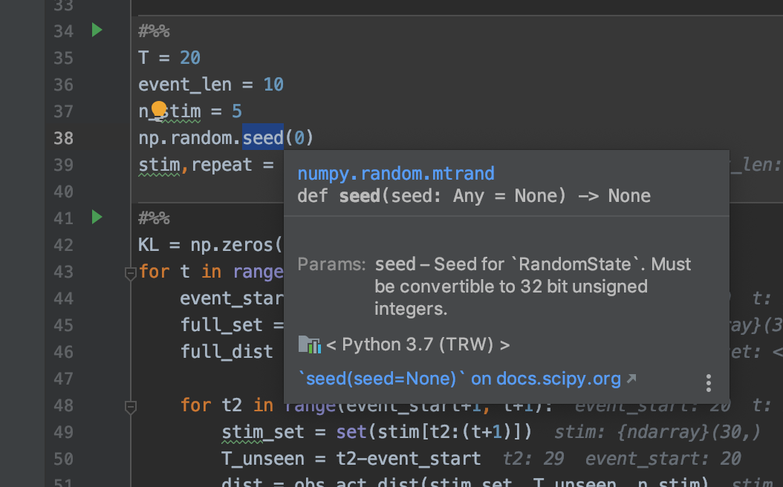
Looking up Documentation
View-> Quick Documentation

Slide 11
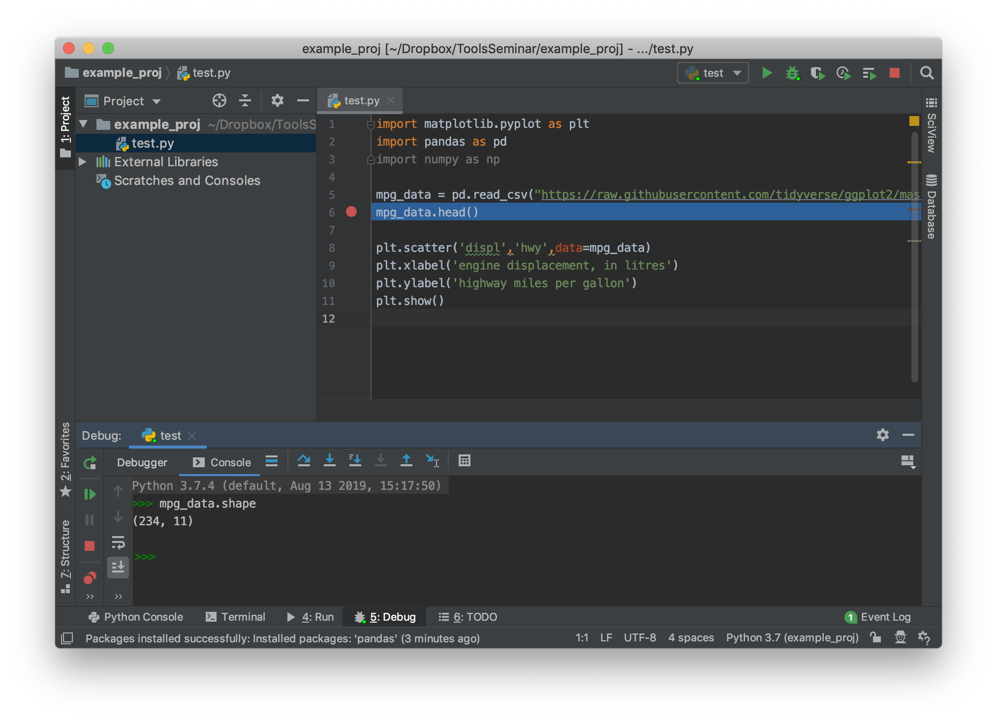
Debugging

Slide 12
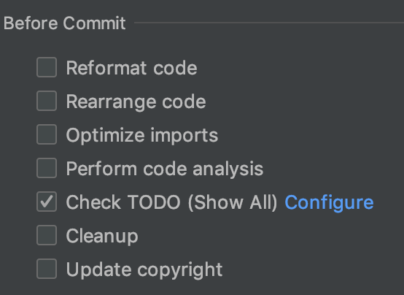
Git integration
Using the VCS (Version Control System) menu, you can stage commits, view diffs, view file histories
GUI allows you to quickly look through multiple files to commit
Can optionally set up trigger actions on commit:

Slide 13
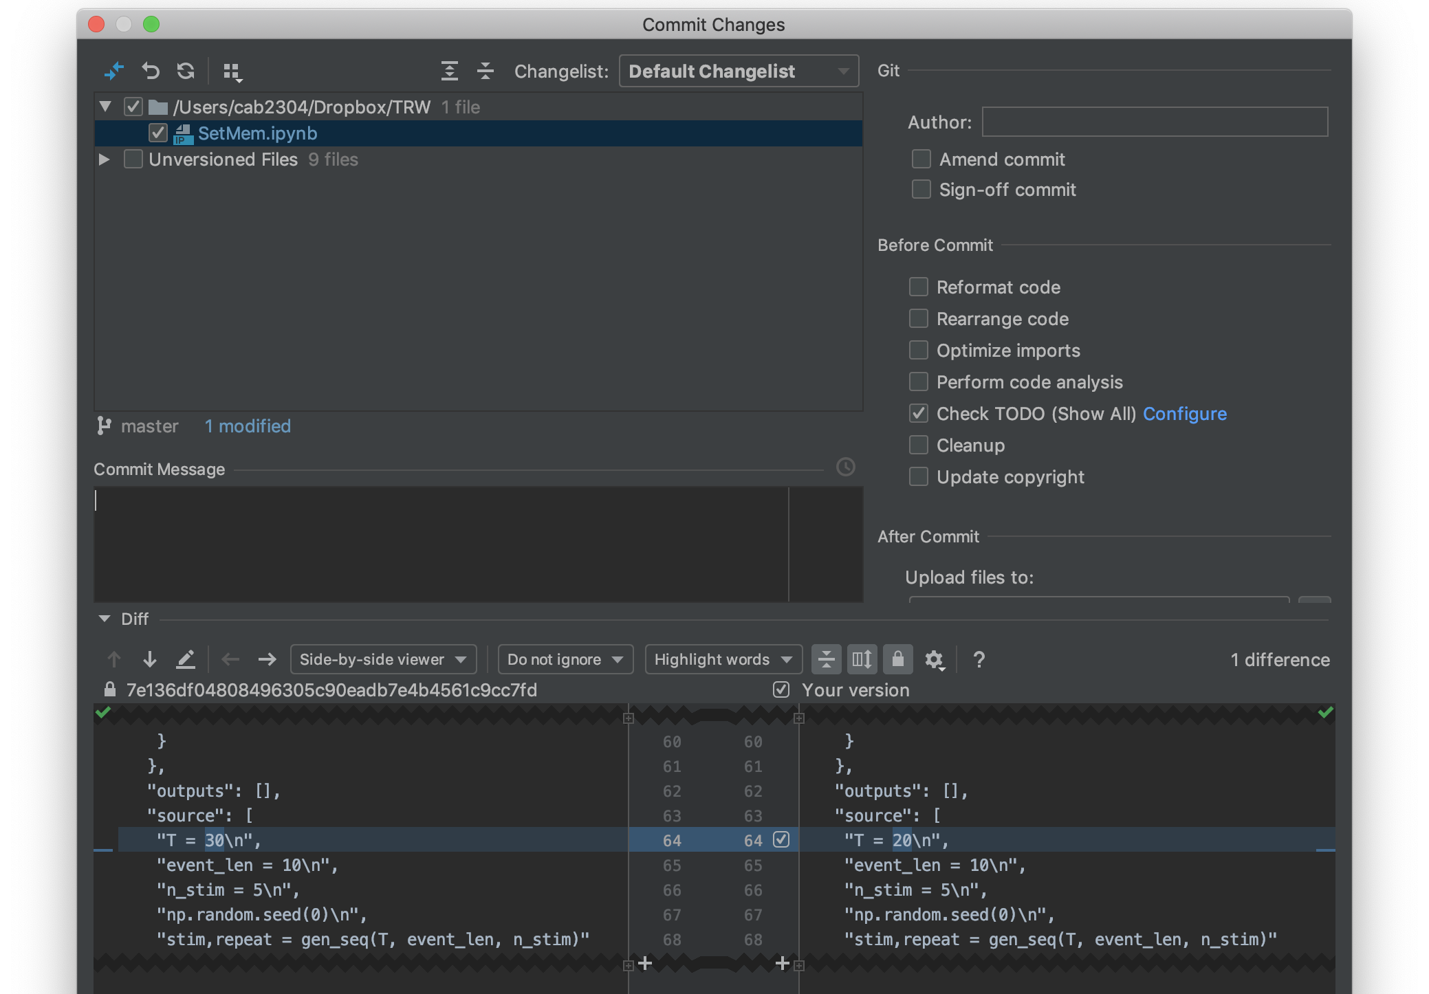
Git integration

Slide 14
Scientific mode
Only available in “Pro” edition – make sure you have the right PyCharm version and have claimed your free .edu license
Allows for more interactive workflows
Saves all plots in a tab for comparison
Can run a full script, or part of a script, or interactively run code in a console
Can view data arrays

Slide 15
Scientific mode

Slide 16
Scientific mode

Slide 17
Scientific mode

Slide 18
Notebooks in PyCharm
You can run a Jupyter server inside PyCharm
Interface is slightly weird – editing is done on a plain text file which is simultaneously rendered as a notebook
Allows debugging in notebook cells

Slide 19
Testing
We’ll cover testing in more detail in a later class
If you create a function that ends in “assert”, PyCharm assumes that it is a test function
You can run one or all test functions to see which ones are failing, and debug failure cases

Slide 20
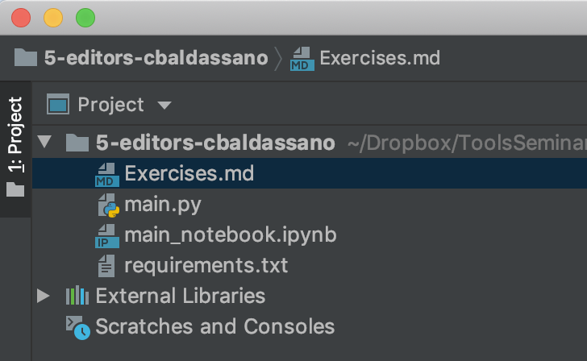
Lab instructions
(Install PyCharm Pro – see my email)
Get a copy of the assignment: https://classroom.github.com/a/X3EKiNlH
Open PyCharm, select “Check out from Version Control”->Git and then paste in the git clone url from GitHub.
Open Exercises.md

